Slide 1
Exam 2 - Review Session
CSCI570 - Spring 2023

Slide 2
Network Flow

Slide 3
(2,6)
(2,4)
5
-4
(1,4)
9
(3,4)
(2,3)
(2,5)
3
-13
(2,5)

Slide 4
(2,6)
2
7
-4
(1,4)
5
(3,4)
(2,3)
3
5
-13
(2,5)

Slide 5
(2,6)
2
10
-4
(1,4)
5
1
(2,3)
3
2
-13
(2,5)

Slide 6
4
2
8
-2
(1,4)
5
1
(2,3)
3
2
-13
(2,5)

Slide 7
4
2
7
-2
3
5
1
(2,3)
3
2
-12
(2,5)

Slide 8
4
2
7
-4
3
5
1
1
3
2
-10
(2,5)

Slide 9
4
2
7
-4
3
5
1
1
3
0
-8
3

Slide 10
t
7
4
5
2
4
3
1
1
s
3
8
3

Slide 11
t
7/7
4/4
3/5
2
3/4
3/3
1
1/1
s
3/3
7/8
3/3

Slide 12
Linear Programming

Slide 13
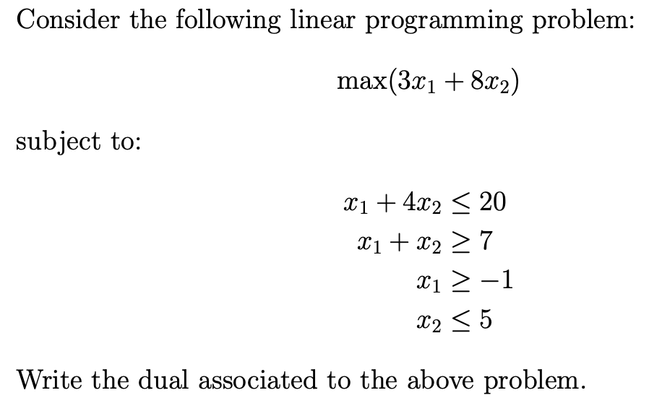

Slide 14
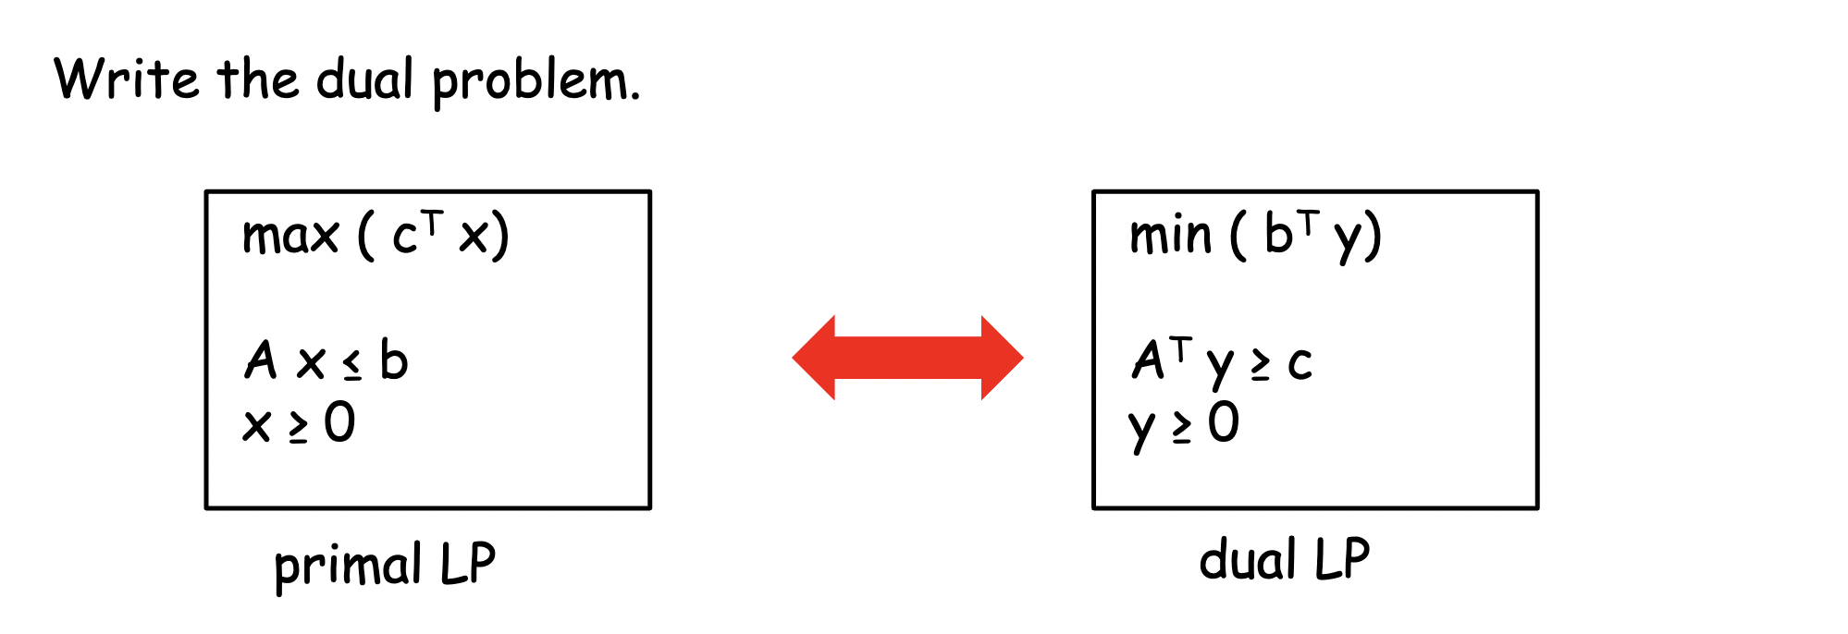

Slide 15
Standardise Inequalities
x1 >= 1, x2 <= 5
x1 - 1 >= 0
-x2 + 5 >= 0
z1 = x1 - 1
z2 = -x2 + 5

Slide 16
Standardise Inequalities
Objective:
max(3z1 - 8z2)
Constraints:
z1 - 4z2 <= 1
-z1 + z2 <= -3
z1, z2 >= 0

Slide 17
Matrix form
z = [z1, z2]^{T}
c = [3, -8]^{T}
b = [1, -3]^{T}
A = [[1,-4],
[-1,1]]
A^{T} = [[1,-1],
[-4,1]]

Slide 18
Solution
min(y1 − 3y2) -> min(b^{T} y)

Slide 19
Solution
min(y1 − 3y2)
Subject To:
y1 −y2 ≥ 3 -> A^{T}y >= c
–4y1+y2 ≥ –8
y1, y2 ≥ 0

Slide 20
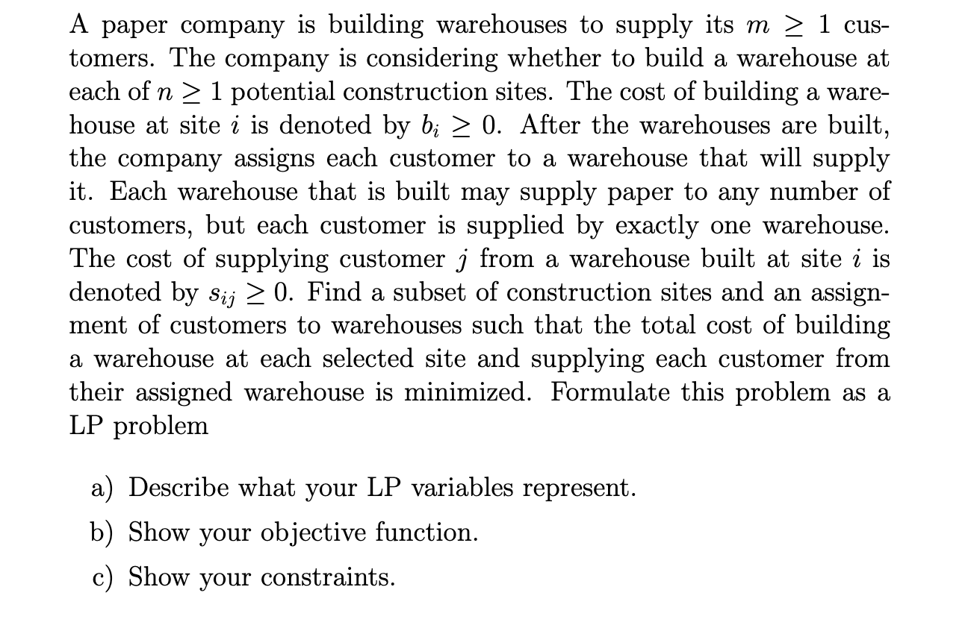

Slide 21
Solution
Let the variables xi ϵ {0, 1} (1 ≤ i ≤ n) indicate whether construction site i was selected, and let the variables yij ϵ {0, 1} (1 ≤ i ≤ n, 1 ≤ j ≤ m) indicate whether a warehouse built at site i supplies customer j.

Slide 22
Solution
b) Min CB + CS s.t.
CB = Σ_{1 ≤ i ≤ n} xi bi (CB is the total cost of building the warehouses)

Slide 23
Solution
b) Min CB + CS s.t.
CB = Σ_{1 ≤ i ≤ n} xi bi (CB is the total cost of building the warehouses)
CS = Σ_{1 ≤ i ≤ n} Σ_{1 ≤ j ≤ m} yij si (CS is the total cost of supplying the customers.)

Slide 24
Solution
c) The constraints are as follows
Σ_{1≤i≤n} yij = 1, 1 ≤ j ≤ m (Each customer is supplied by exactly one warehouse.)

Slide 25
Solution
c) The constraints are as follows
Σ_{1≤i≤n} yij = 1, 1 ≤ j ≤ m (Each customer is supplied by exactly one warehouse.)
xi − yij ≥ 0, 1 ≤ i ≤ n & 1 ≤ j ≤ m (A warehouse built at site i may only supply customer j if site i was selected.)

Slide 26
Solution
c) The constraints are as follows
Σ_{1≤i≤n} yij = 1, 1 ≤ j ≤ m (Each customer is supplied by exactly one warehouse.)
xi − yij ≥ 0, 1 ≤ i ≤ n & 1 ≤ j ≤ m (A warehouse built at site i may only supply customer j if site i was selected.)
xi ϵ {0, 1}, 1 ≤ i ≤ n (Construction site i is either selected or not.)

Slide 27
Solution
c) The constraints are as follows
Σ_{1≤i≤n} yij = 1, 1 ≤ j ≤ m (Each customer is supplied by exactly one warehouse.)
xi − yij ≥ 0, 1 ≤ i ≤ n & 1 ≤ j ≤ m (A warehouse built at site i may only supply customer j if site i was selected.)
xi ϵ {0, 1}, 1 ≤ i ≤ n (Construction site i is either selected or not.)
yij ϵ {0, 1}, 1 ≤ i ≤ n & 1 ≤ j ≤ m (A warehouse at site i supplies customer j, or does not.)

Slide 28
Approximation Algorithm

Slide 29
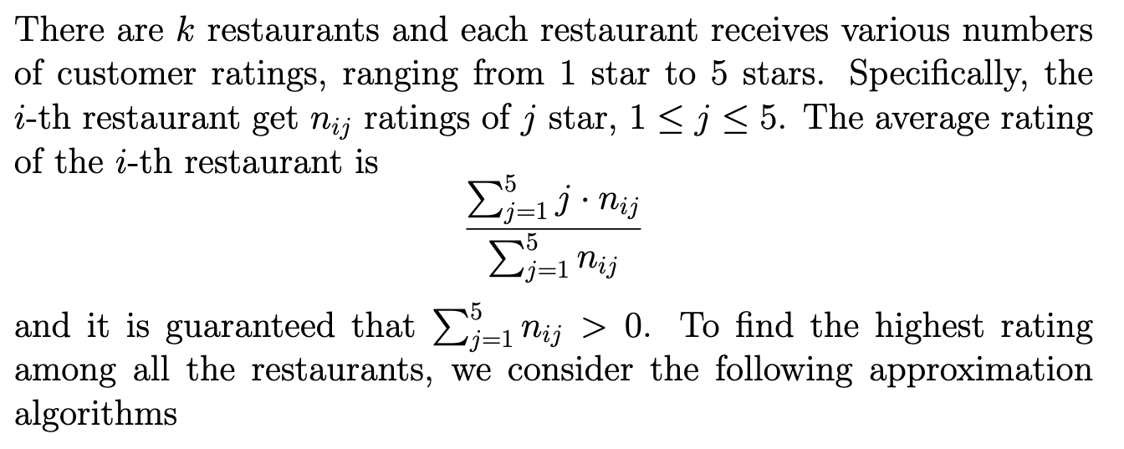

Slide 30
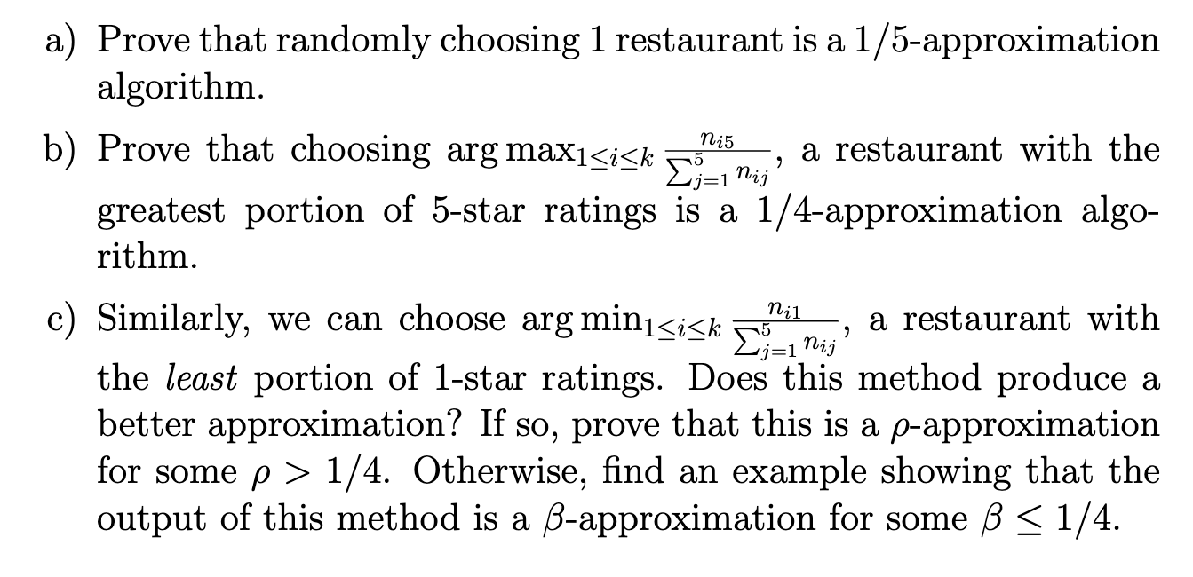

Slide 31
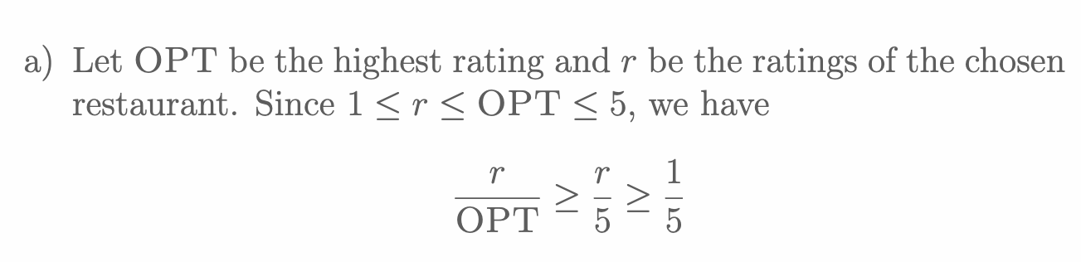

Slide 33
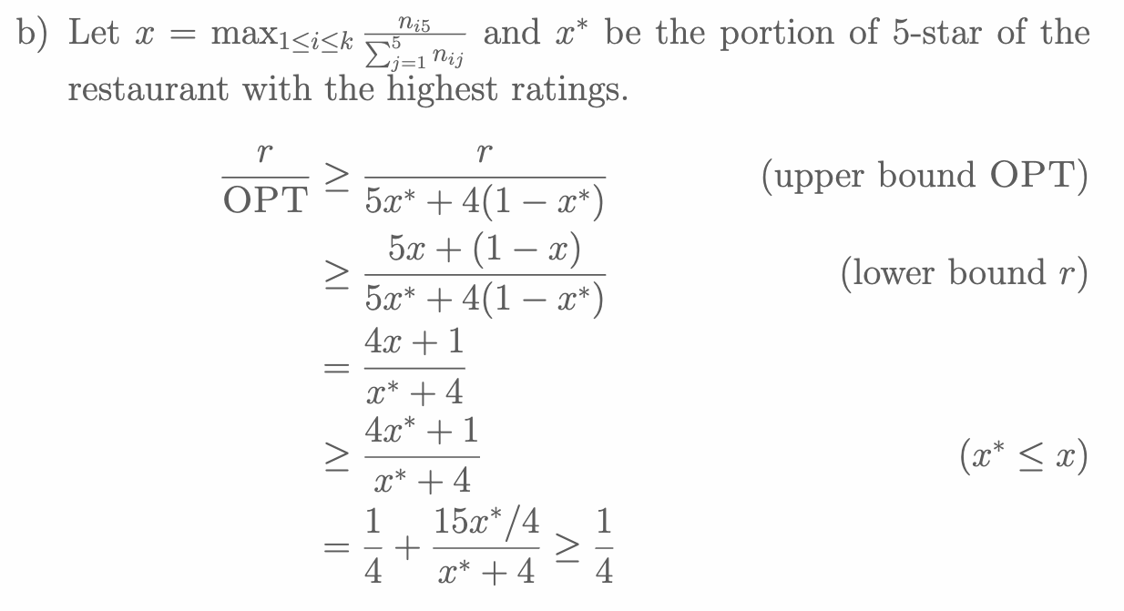

Slide 39
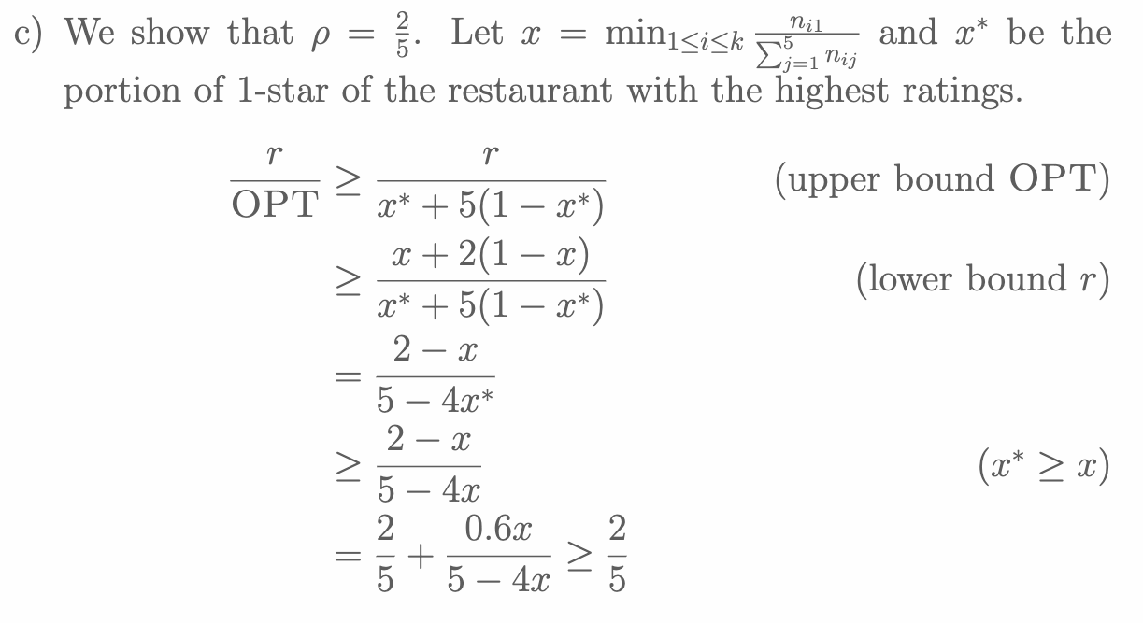

Slide 45
NP Completeness

Slide 46
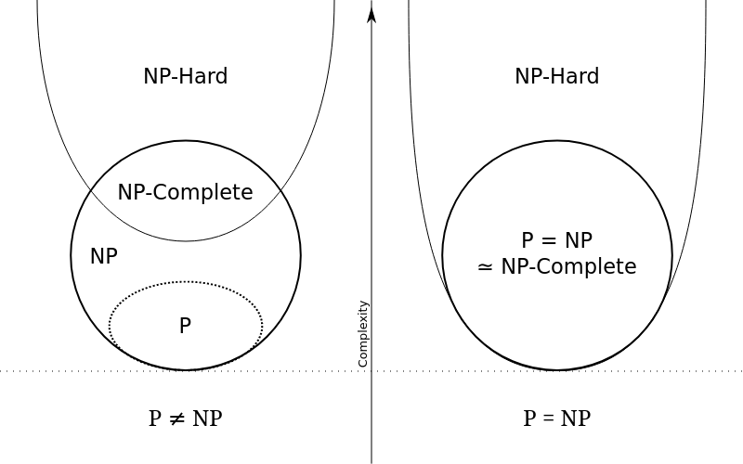

Slide 47
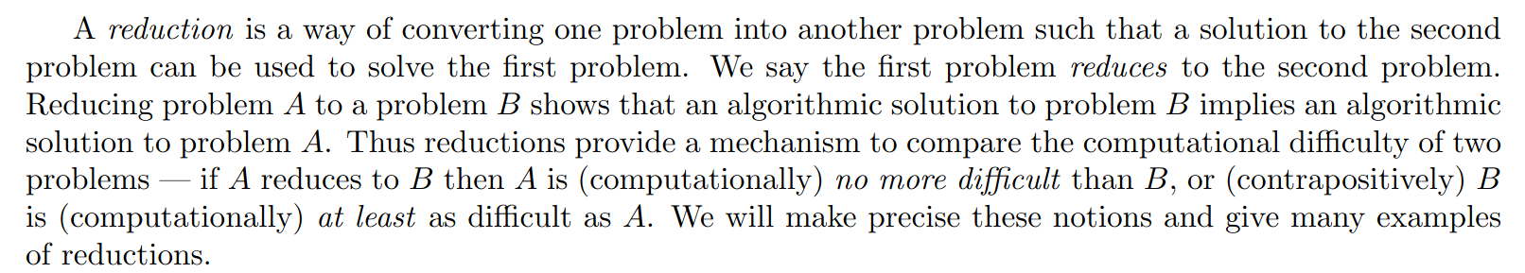
Reduction

Slide 48
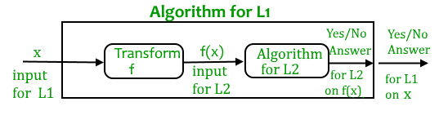
Reduction

Slide 49
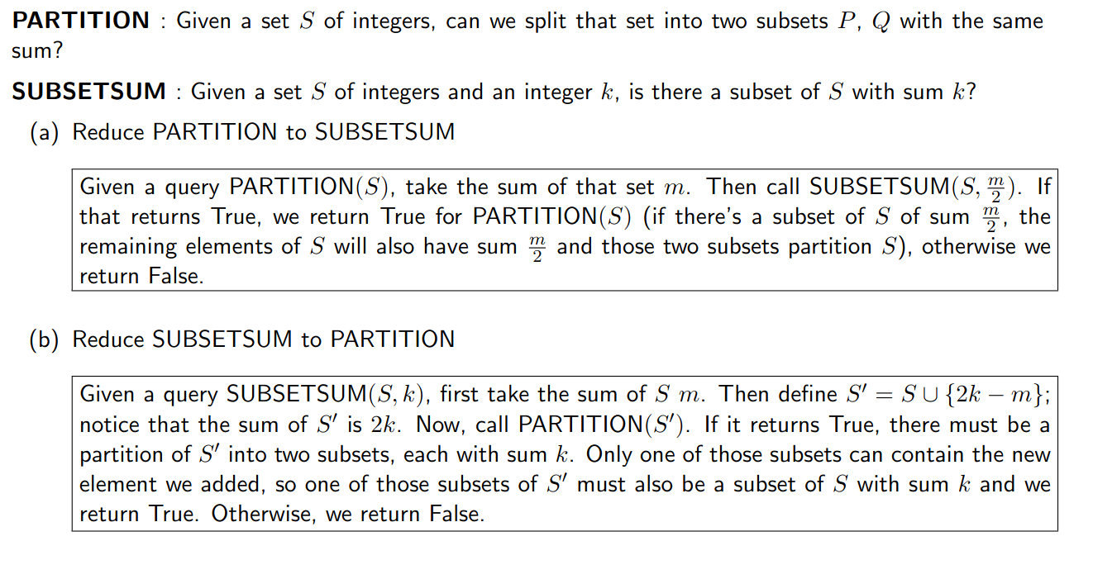

Slide 50
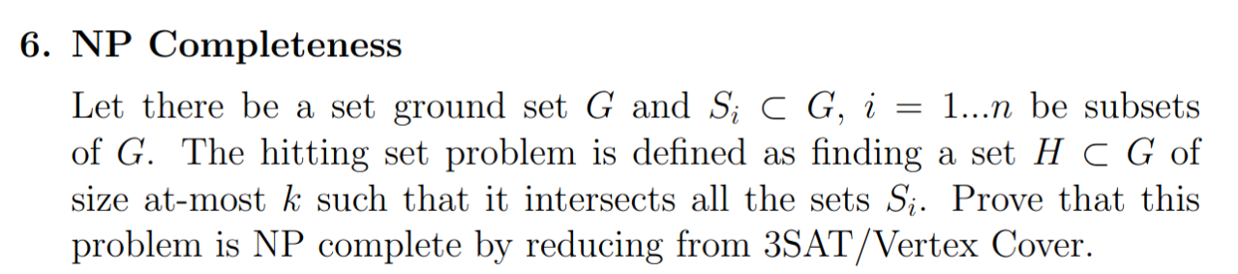

Slide 51
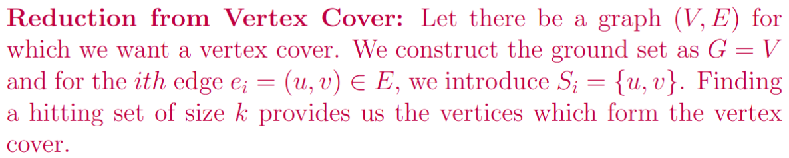

Slide 53
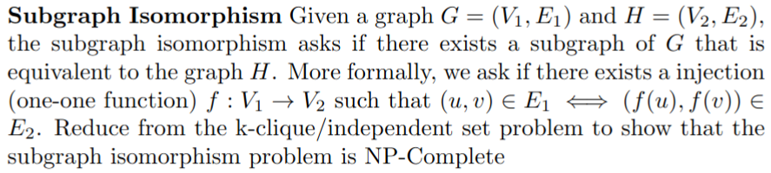

Slide 54
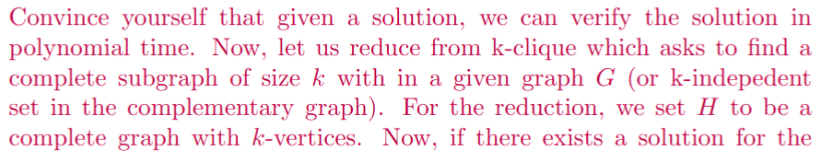
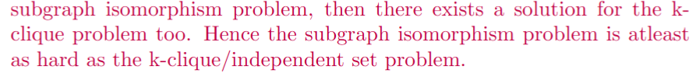

Slide 55
True or False

Slide 56
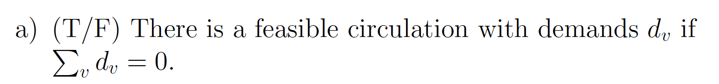

Slide 57
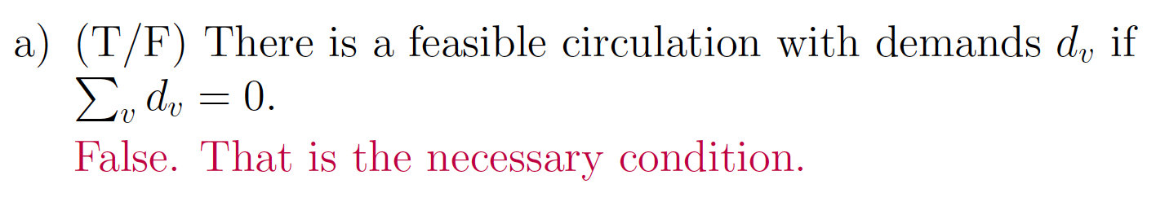

Slide 58
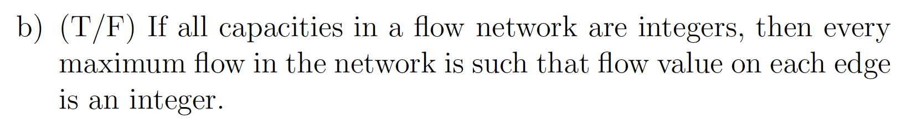

Slide 59
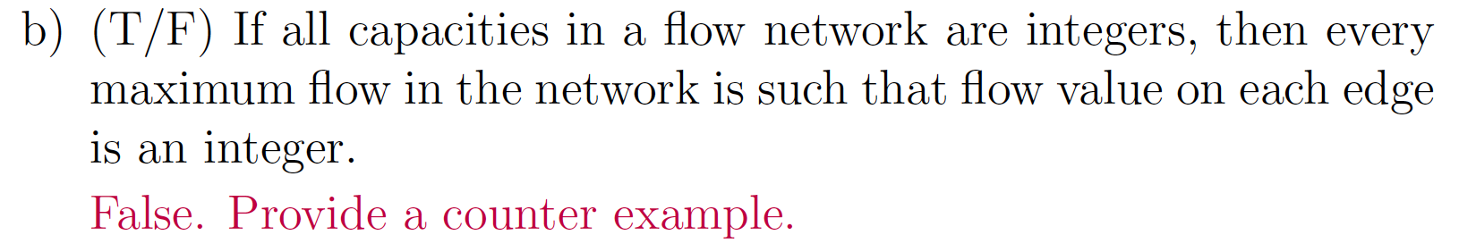
1.5/5
1.5/5
2/2
0.5/5
0.5/5

Slide 60
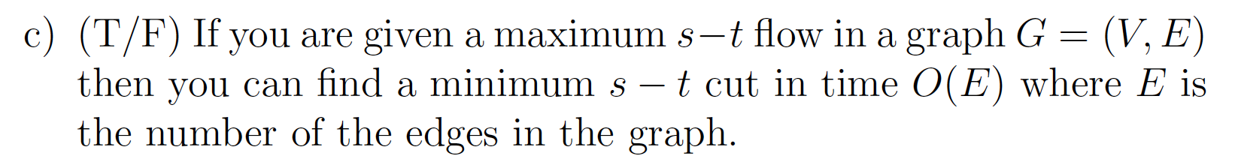

Slide 61
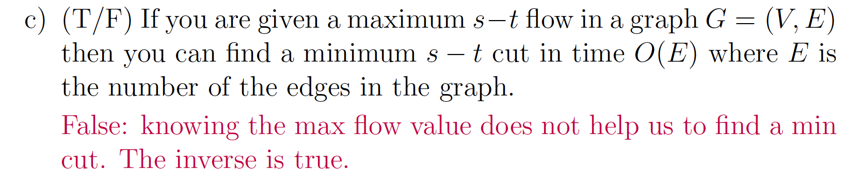

Slide 62
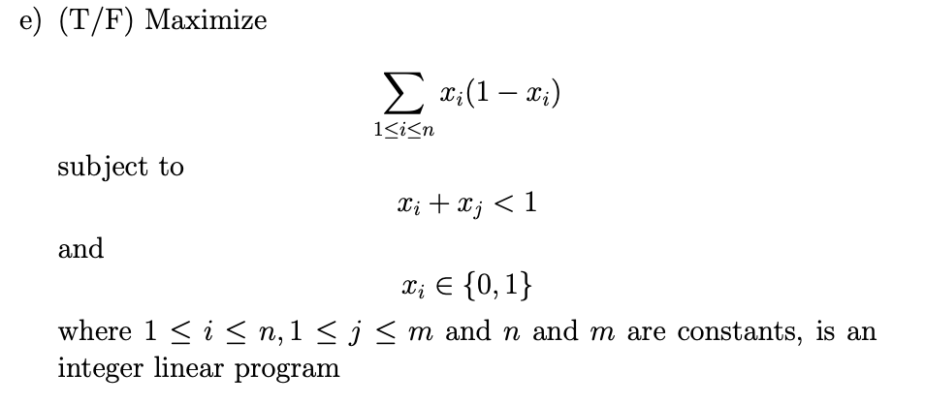

Slide 63
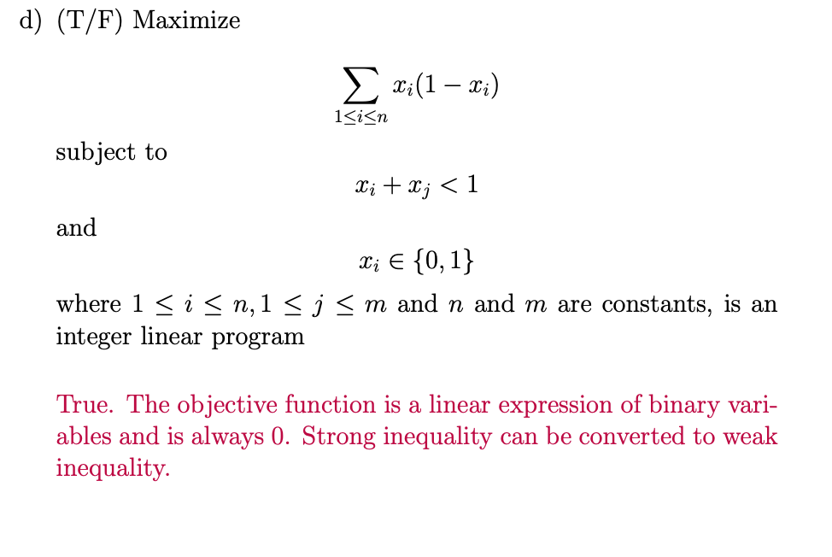

Slide 64


Slide 65
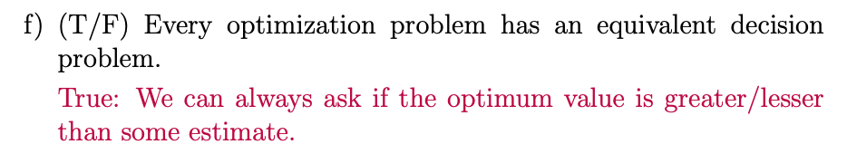

Slide 67
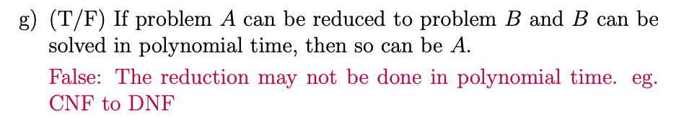

Slide 69


Slide 71


Slide 73
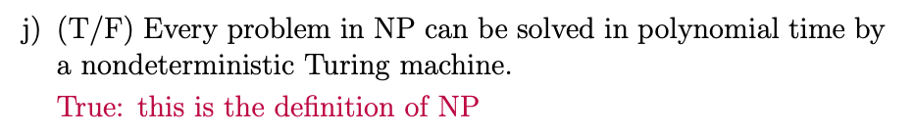

Slide 74
Multiple Choice

Slide 75
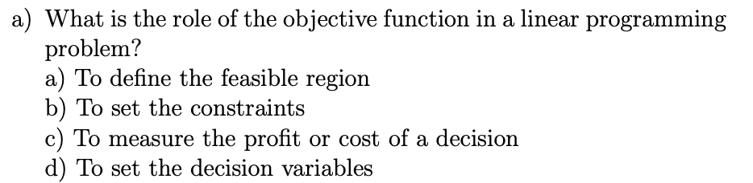

Slide 76
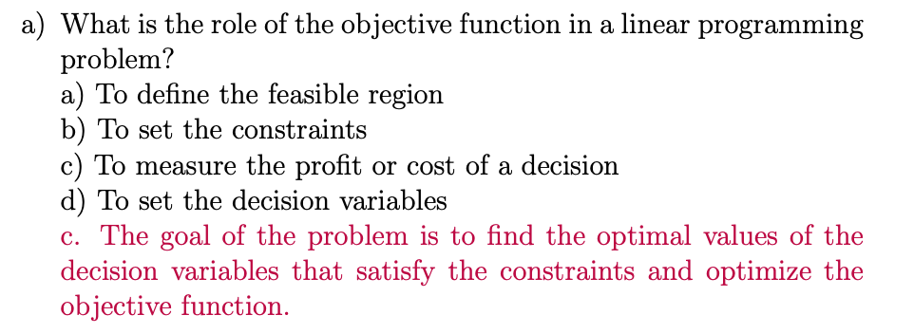

Slide 77
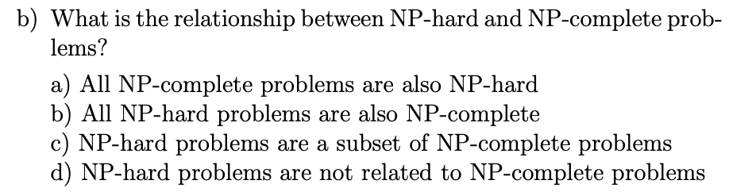

Slide 78
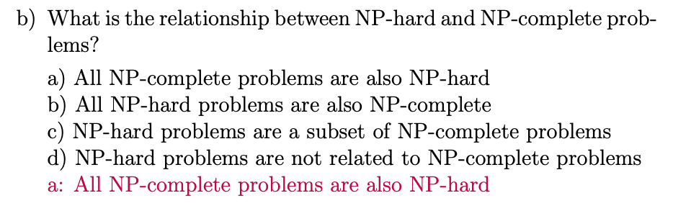

Slide 79
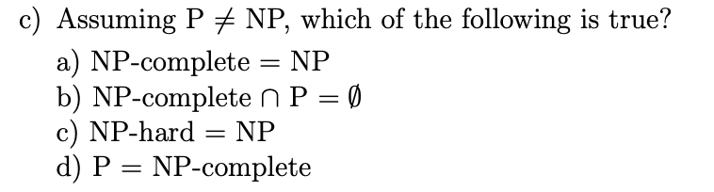

Slide 80
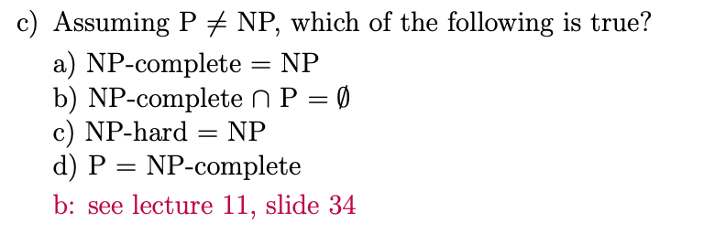

Slide 81
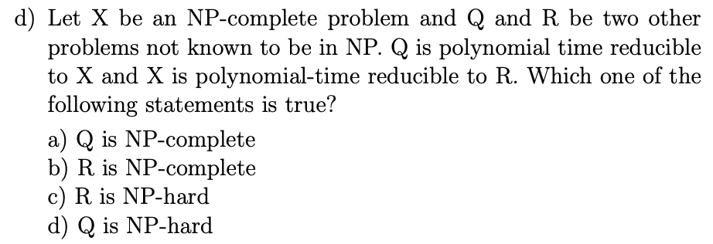

Slide 82
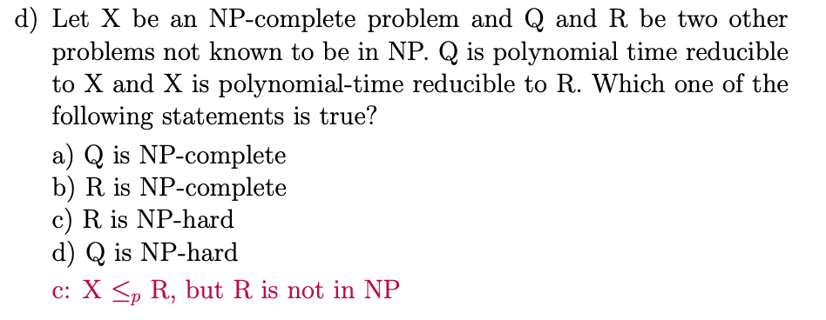

Slide 83
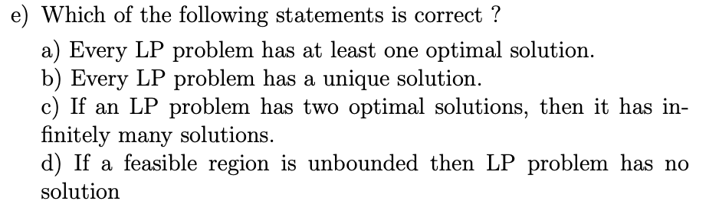

Slide 84
